Slide 1
Hacking A Car
Katherine Bixler, Aaron Harkrider, Joy Shaffer, Ally Wallace

Slide 2
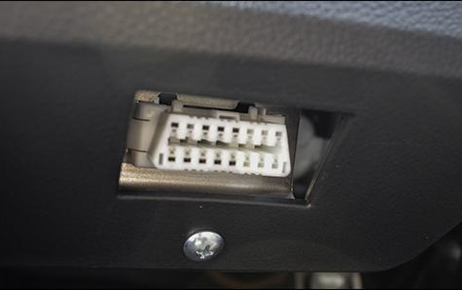
Ways to Hack a Car
Remotely
Over a cellular network
On-Site
Through the OBD-II connector
Both methods rely on controlling the CAN bus
It’s not easy!!
No industry standard
Each car is different
Most things have not been mapped
“Security through obscurity”
Not good
Notes:
Katherine
Mention: Arduino/Microcontroller
Can buy device just to read output (not write to it)

Slide 3
The CAN Bus

Slide 4
Cables/Parts We Used
CANtact
Open-source hardware by Eric Evenchick
USB-B cable to interface with computer
OBD-II to DB9 connector
Notes:
Ally

Slide 5
OBD-II
A mandated diagnostic interface
Provides specific information including engine data, trouble codes and more
PIDs - Code used to request data from a vehicle
Notes:
Ally

Slide 6
The CAN Bus
Controller Area Network
CAN arbitration ID (green in next image)
11 - bit field for identifying different devices on the CAN bus
Prioritize messages
CAN data (red in next image)
0-64 - bits in length
Tells the receiving device what function to perform
Notes:
Joy
Controller Area Network which is a vehicle bus standard to allow microcontrollers and devices to communicate with each other without a host computer.
Two important parts of the CAN Bus are the arbitration ID and the data.
The receiving device - in this case the car - what function to perform

Slide 7
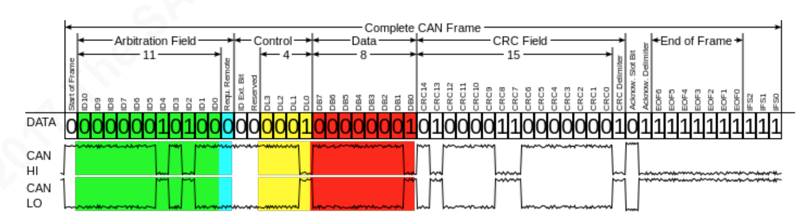
The CAN Bus
CAN arbitration ID (green)
CAN data (red)
Notes:
Joy
Diagram of the CAN Frame

Slide 8
CANtact

Slide 9
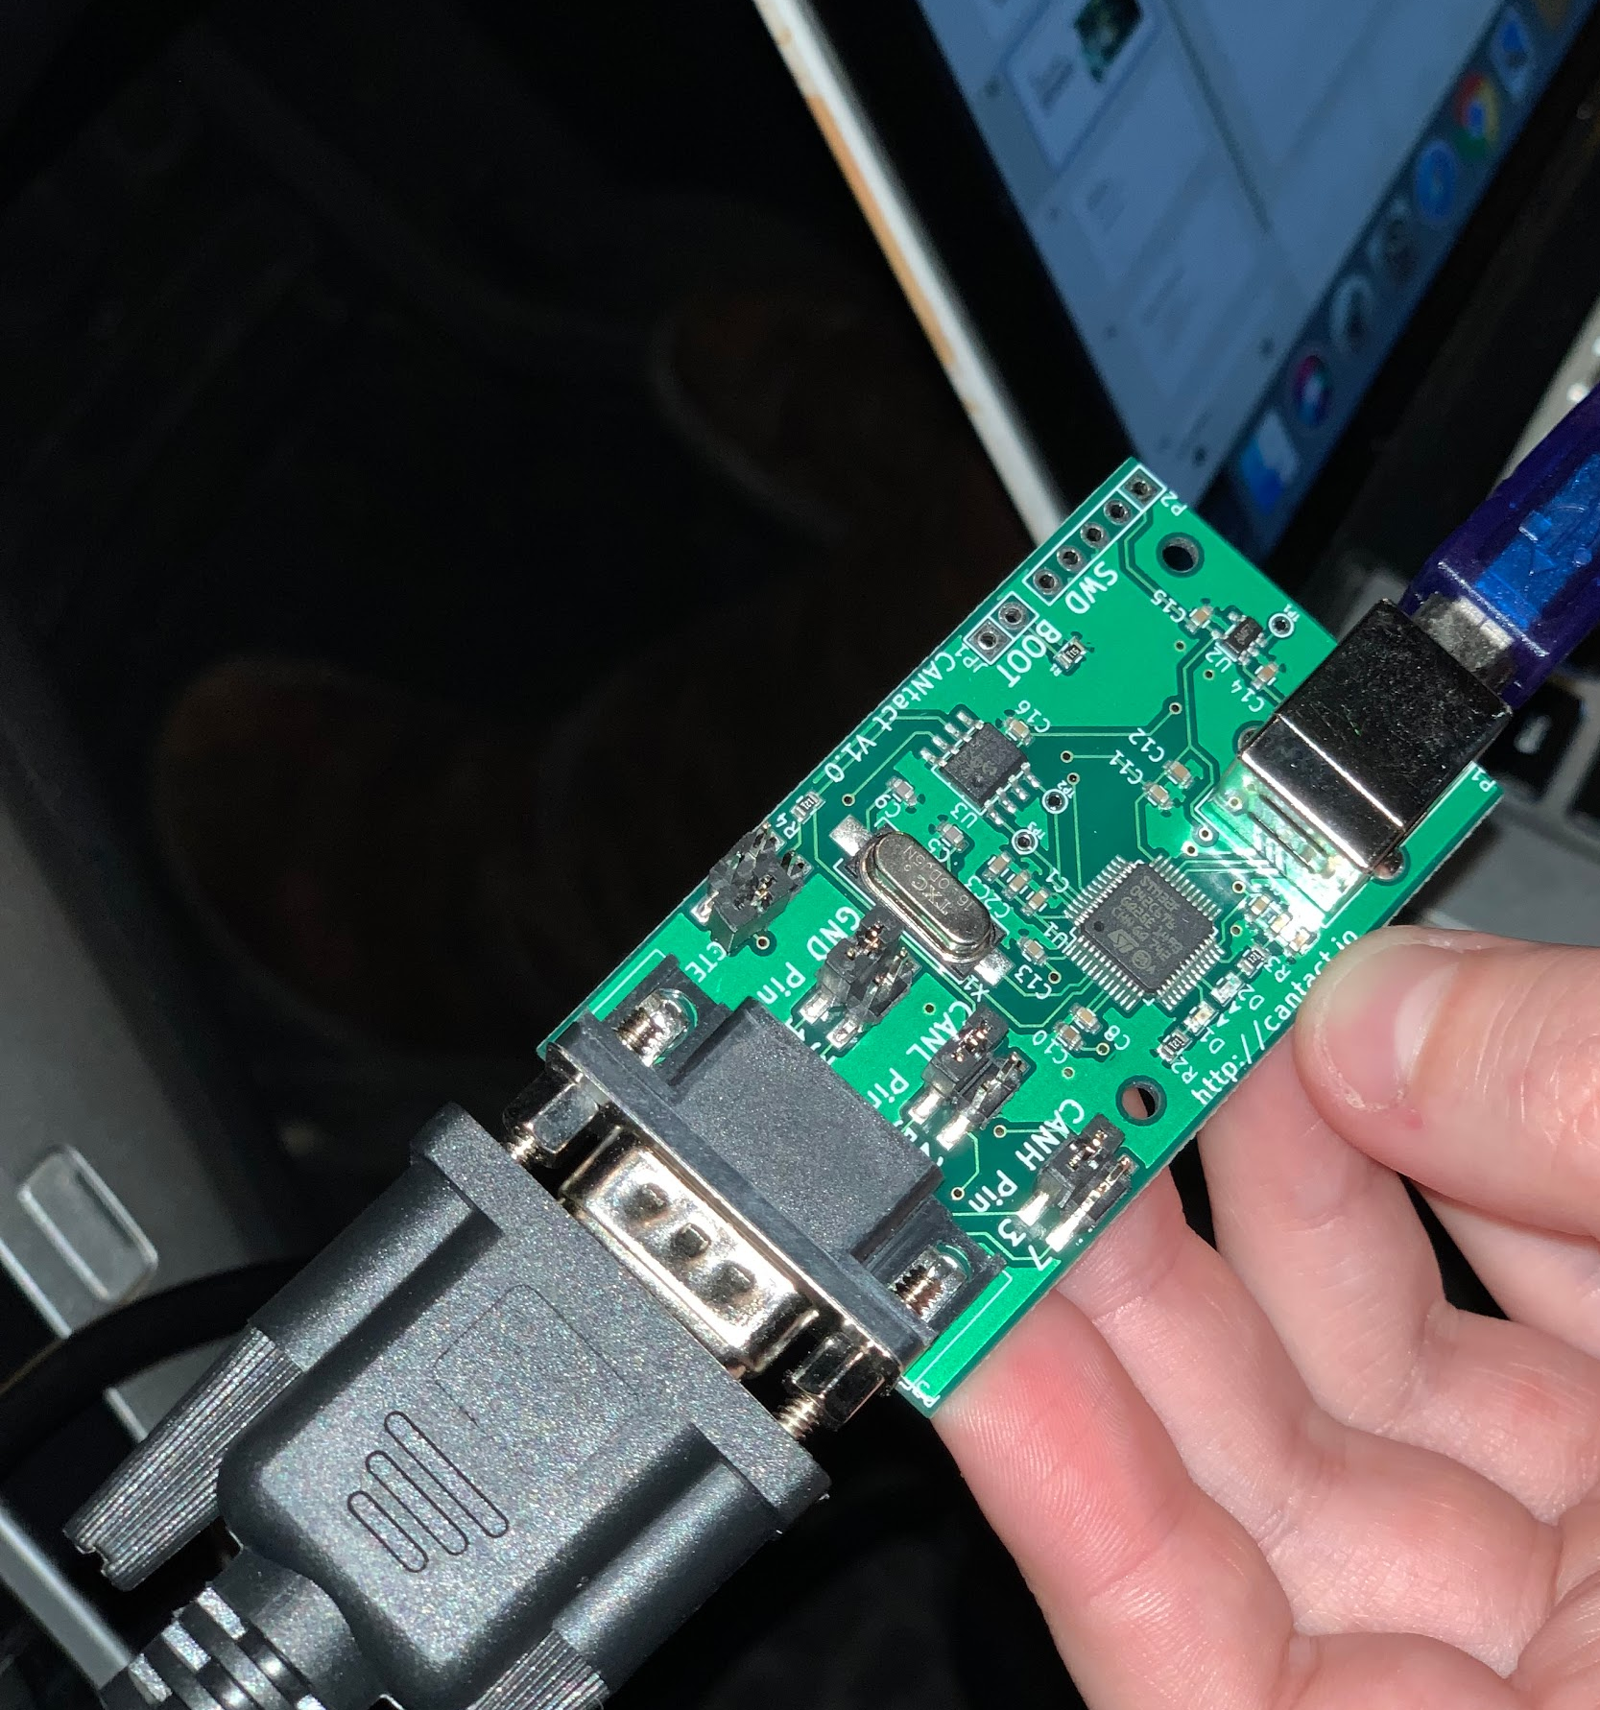
The CANtact
Notes:
Joy
Again, the CANtact was created by Eric Evenchick (Evan chick)

Slide 10
CANtact
CAN to USB
Based around the ST STM32F042C6 microcontroller
Microchip MCP2561 CAN transceiver
Cross Platform
Designed for hacking
Python library
On OS X & Linux, no drivers are required
Notes:
Joy
Open source CAN to USB interface for your computer. Based around a microcontroller with a microchip CAN transceiver. It is cross platform so it can be used on MAC, Linux, or Windows. Some other notable things about the CANtact that were helpful for us is that it is intended to be used for hacking so there was a python library that we could utilize. Also, with OS and Linux, there were no drivers required to use the CANtact.

Slide 11
Our Process & Setup
Notes:
Aaron

Slide 12
Command line Ubuntu Setup
Installed Linux Ubuntu
Installed git
Installed Can-utils
Loaded the can modules
Notes:
Aaron

Slide 13
Flashing/Updating Firmware
Updated over USB
On Ubuntu, install dfu-util with: sudo apt install dfu-util
Steps:
Disconnect the USB cable from the CANtact
Connect the two "BOOT" pins
While the pins are connected, plug the USB cable into the CANtact
The CANtact device is now in DFU mode
Notes:
Aaron

Slide 14
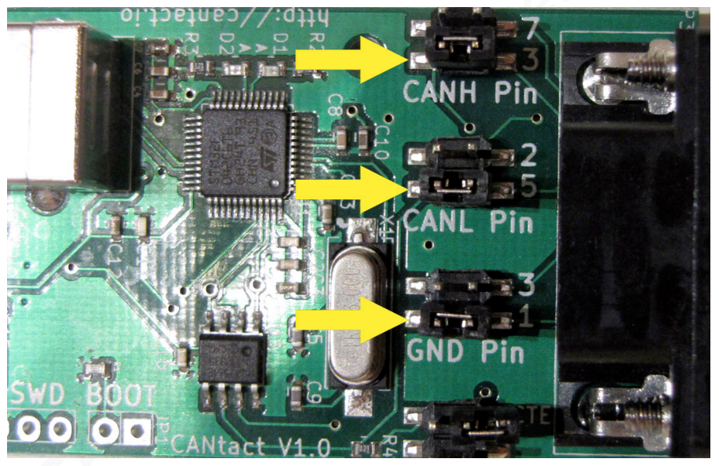
Pin Configuration
https://www.sans.org/reading-room/whitepapers/threats/hacking-bus-basic-manipulation-modern-automobile-through-bus-reverse-engineering-37825
(Page 27)
Notes:
Joy
The CANtact has these physical jumpers that need to be set according to the type of connection being used.
With an OBD-II to DB9 cable, you must put the jumpers on CAN High on pin 3, CAN Low on pin 5, and Ground on pin 1.

Slide 15
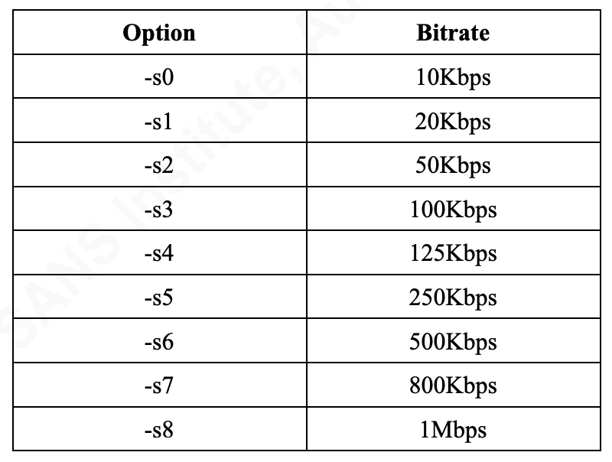
CAN Bus Bitrate
Rate to read messages from vehicle
Set ours at 500Kbps
Important to have the correct bitrate to communicate with the vehicle
Notes:
Joy
Kilobits per second
-s6

Slide 16
Ally’s Car Issue
Caused many dilemmas
Tried changing the bit rate
Connected OBD-II to the computer and no output came through
Ran command to read any output from port:
screen /dev/cu.usbmodem1421
Notes:
Ally

Slide 17
Read from Vehicle
from pyvit import can
from pyvit.hw.cantact import CantactDev
dev = CantactDev("/dev/cu.usbmodem1421")
dev.set_bitrate(500000)
dev.start()
while True:
print(dev.recv())
Notes:
Ally
Dev.recv outputting in a format we can read not interpreting it

Slide 18
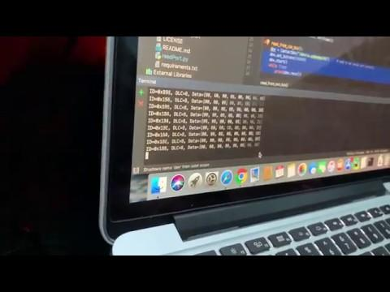
Notes:
Ally

Slide 19
Output
ID=0x295, DLC=4, Data=[00, 00, 00, 35]
ID=0x091, DLC=8, Data=[80, 00, 08, 06, 00, 00, 00, 08]
ID=0x156, DLC=6, Data=[F6, FD, 00, 00, 07, 22]
ID=0x134, DLC=5, Data=[04, 00, 00, 02, 0A]
ID=0x13C, DLC=8, Data=[FF, C8, FF, C8, 00, 00, 04, 00]
ID=0x158, DLC=8, Data=[00, 00, 02, F0, 00, 00, 00, 09]
ID=0x17C, DLC=8, Data=[00, 00, 02, F4, 00, 00, 00, 0F]
ID=0x188, DLC=6, Data=[00, 00, 00, 01, 00, 33]
ID=0x1DC, DLC=4, Data=[02, 02, F4, 25]
ID=0x1ED, DLC=3, Data=[01, FF, 2B]
Notes:
Ally

Slide 20
Interpreting the Car’s Data
https://en.wikipedia.org/wiki/OBD-II_PIDs
https://www.csselectronics.com/screen/page/obd-ii-online-message-converter
ID=0x18E, DLC=3, Data=[00, 00, 2F]
ID=0x039, DLC=3, Data=[00, 00, 39]
ID=0x091, DLC=8, Data=[80, 00, 08, 06, 00, 00, 00, 17]
Notes:
Katherine

Slide 21
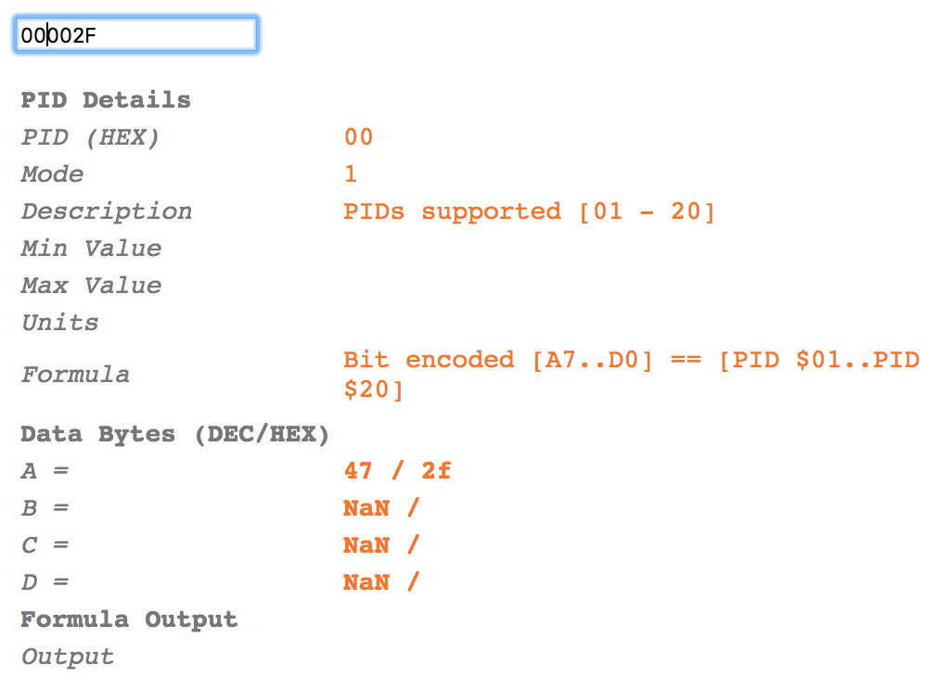
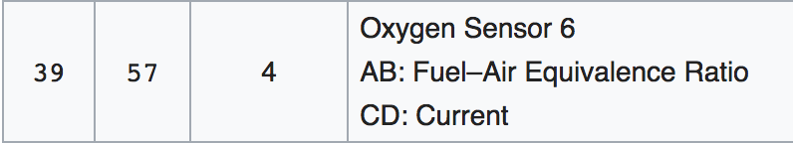

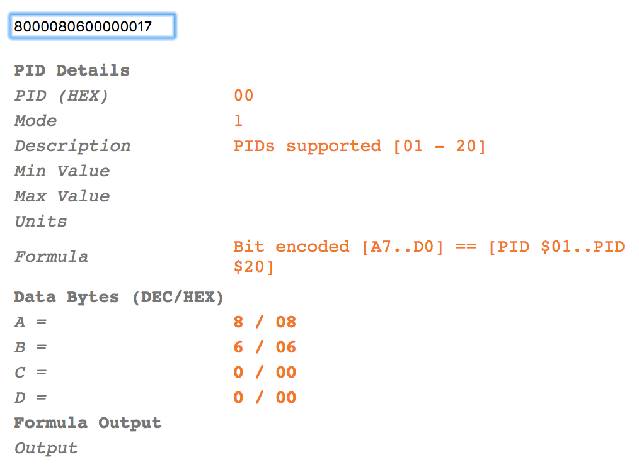
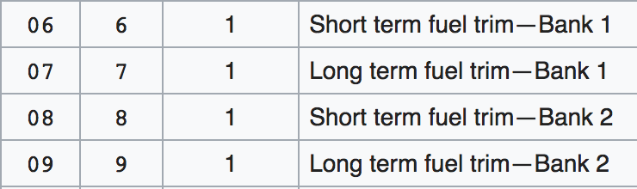
Notes:
Katherine

Slide 22
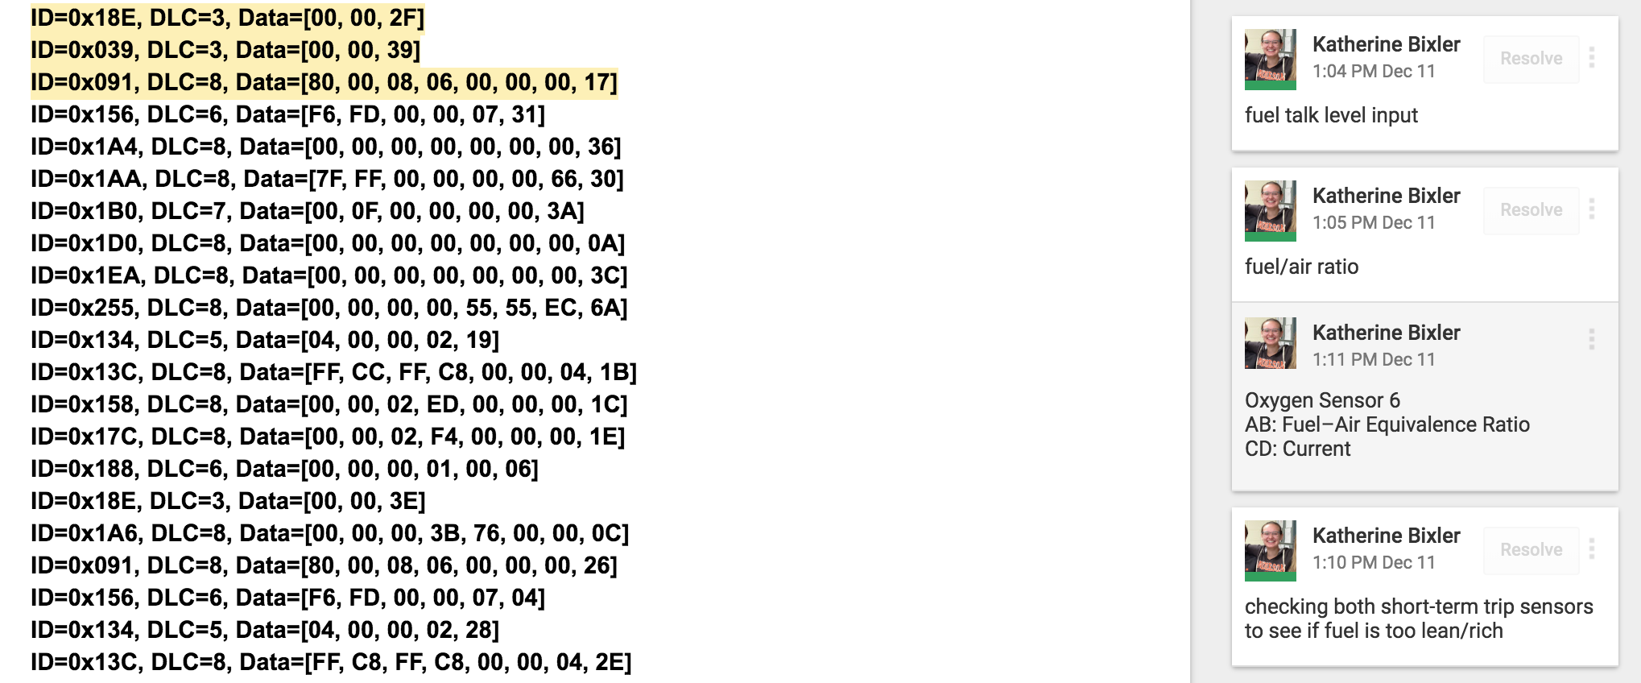
Notes:
Katherine

Slide 23
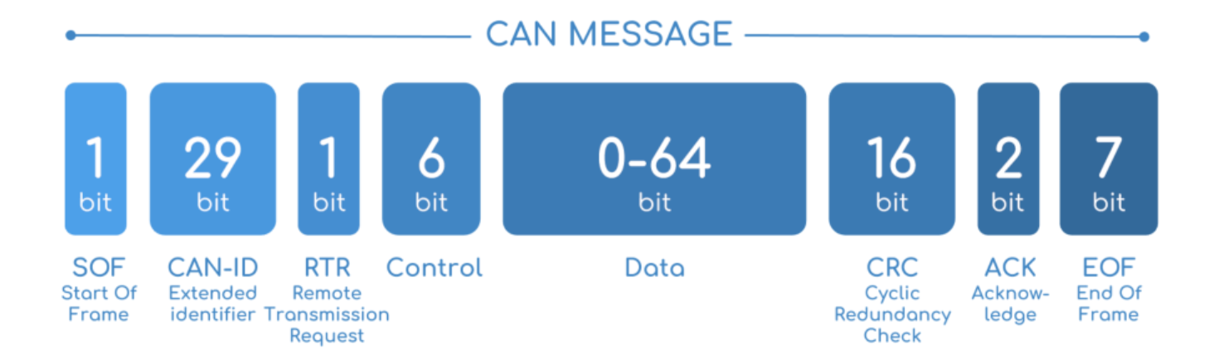
Other Ways to Interpret the CANtact/CAN Bus
CAN Bus Sniffing with Wireshark
Pyvit has interpreter
CAN Bus Data
3 Important Parts: CAN ID, Control, Data field
Notes:
Aaron

Slide 24
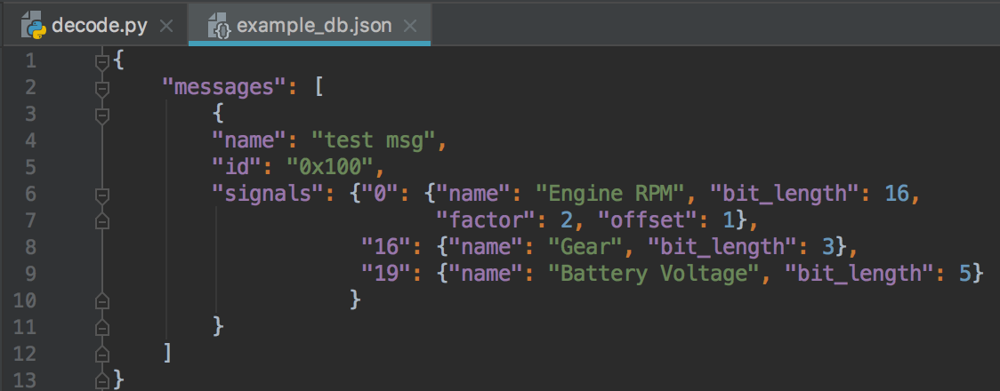
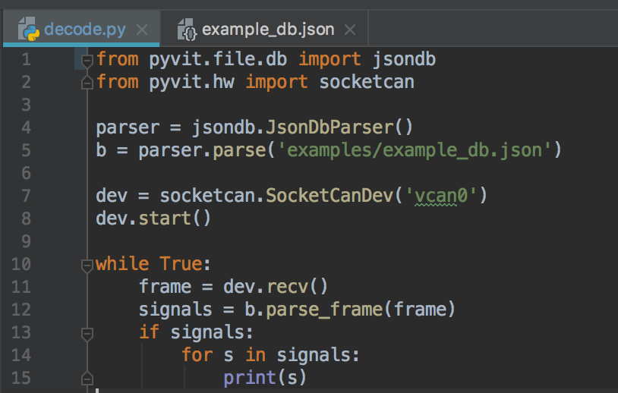
Automating CAN bus Sniffing
python code from pyvit repository
Notes:
Aaron
The “pyvit” repository contains python code that can be used for sniffing the can bus messages. These two classes here are examples of code to decode the can massages into readable json.

Slide 25
Lessons Learned

Slide 26
Problems We Ran Into
Error: conflicting cpu architectures
Could not flash firmware
Had to install packages
Libnewlib-arm-none-eabi
Ally’s OBD-II didn’t work (Honda Accord ‘07)
Aaron’s OBD-II was difficult to get to (Honda Accord ‘04)
Joy’s worked! (Honda CRV ‘14)
Hard time at first decoding the output
No industry standard for language of output
Could not read every single line of output
Notes:
Joy
Ally’s OBD-II may have been broken

Slide 27
Repository
https://github.com/linklayer: Cantact-fw, Pyvit
Code example to write: https://github.com/linklayer/pyvit/blob/master/examples/cantact.py
Our code: https://github.com/awharkrider/CPSC_3320_HACK_A_CAR
Notes:
Ally
Fw- used to flash hardware
Pyvit- used to read/write/interperet

Slide 28
Questions?

Slide 29
References
Roderick Currie, 2017. Hacking the CAN Bus: Basic Manipulation of a Modern Automobile Through CAN Bus Reverse Engineering. https://www.sans.org/reading-room/whitepapers/threats/hacking-bus-basic-manipulation-modern-automobile-through-bus-reverse-engineering-37825
CAN BUS SNIFFER - REVERSE ENGINEERING VEHICLE DATA (WIRESHARK), CSS Electronics https://www.csselectronics.com/screen/page/reverse-engineering-can-bus-messages-with-wireshark/language/en
ONLINE OBD2 CONVERTER: PID INFO & CALCULATION, CSS Electronics https://www.csselectronics.com/screen/page/obd-ii-online-message-converter
OBD-II_PIDs, Wikipedia. https://en.wikipedia.org/wiki/OBD-II_PIDs
https://www.csselectronics.com/screen/page/simple-intro-to-can-bus/language/en
CANTact, The Open Source Car Tool. http://linklayer.github.io/cantact/
Notes:
Ally
Fw- used to flash hardware
Pyvit- used to read/write/interperet

